Slide 1
SOTWARE TESTING (CS-497)
Course Instructor: AMIR IMAM

Slide 2
Syllabus Chapter 4
Test Design Techniques
Dynamic Technique
Structured Based
Specification Based
Experience Based

Slide 3
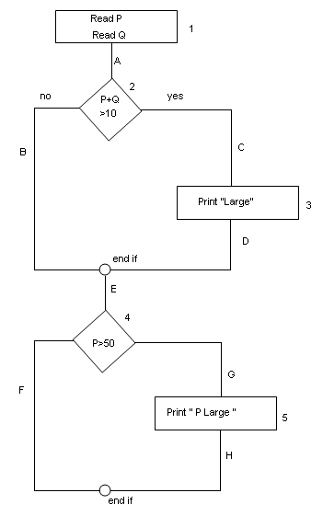

Structured Based – White Box Techniques
Statement Testing and Coverage
Decision Testing and Coverage
Condition Testing and Coverage

Slide 4
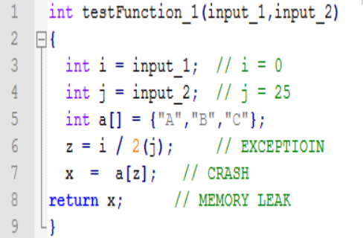
Statement Testing and Coverage
Test Data: input_1 = 2 input_2 = 3
Test Data: input_1 = 100 input_2 = 25
Test Data: input_1 = 0 input_2 = 25

Slide 5
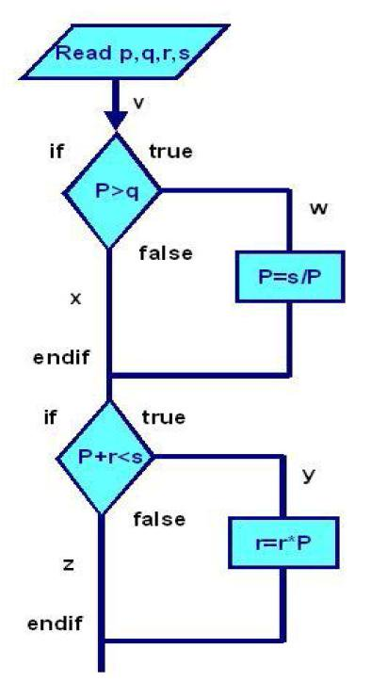
Statement Testing and Coverage
Test Data

Slide 6
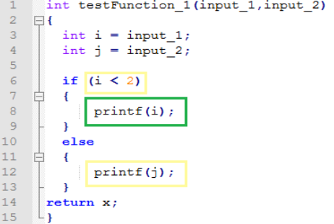
Decision and Condition Coverage
Test Data: input_1 = 2 input_2 = 3
Test Data: input_1 = 1 input_2 = 3

Slide 7
Decision and Condition Coverage
Test Data:

Slide 8
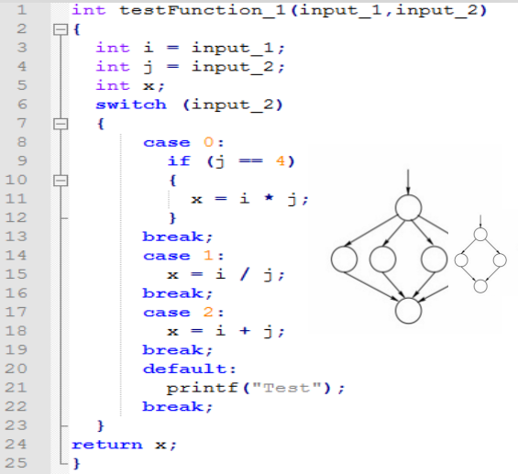
Decision and Condition Coverage
Test Data: input_1 = 1 input_2 = 0
Test Data: input_1 = 0 input_2 = 4
Test Data: input_1 = 0 input_2 = 1

Slide 9
Branch Coverage
Test Data:

Slide 10
Experienced Based Techniques
In experience-based techniques, people’s knowledge, skills and background are of prime importance to the test conditions and test cases.
The experience of both technical and business people is required.
Experience-based techniques go together with specification-based and structure-based techniques, and are also used when there is no specification, or if the specification is inadequate or out of date.
This may be the only type of technique used for low-risk systems, but this approach may be particularly useful under extreme time pressure – in fact this is one of the factors leading to exploratory testing.

Slide 11
Experienced Based Techniques
Error Guessing
Exploratory Testing

Slide 12
What is Error guessing in software testing?
A structured approach to the error-guessing technique is to list possible defects or failures and to design tests that attempt to produce them.
These defect and failure lists can be built based on the tester’s own experience or that of other people, available defect and failure data, and from common knowledge about why software fails.
Typical conditions to try include division by zero, blank (or no) input, empty files and the wrong kind of data (e.g. alphabetic characters where numeric are required).

Slide 13
What is Exploratory Testing in software testing?
Exploratory testing is a hands-on approach in which testers are involved in minimum planning and maximum test execution.
The planning involves the creation of a test charter, a short declaration of the scope of a short (1 to 2 hour) time-boxed test effort, the objectives and possible approaches to be used.
Test logging is undertaken as test execution is performed, documenting the key aspects of what is tested, any defects found and any thoughts about possible further testing.

Slide 14
Specification Based Techniques
Equivalence partitioning
Boundary value analysis
Decision tables
Use Case testing
State transition testing

Slide 15
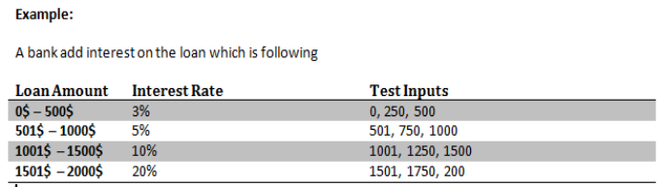
Specification Based – Black Box
Boundary Value
Equivalence Class Partitioning

Slide 16
Specification Based – Black Box
Boundary Value
Equivalence Class Partitioning
In a system designed to work out the tax to be paid:
An employee has £4000 of salary tax free. The next £1500 is taxed at 10%
The next £28000 is taxed at 22%
Any further amount is taxed at 40%
To the nearest whole pound, which of these is a valid Boundary Value Analysis test case?
a) £1500
b) £32001
c) £33501
d) £28000

Slide 17
Specification Based – Black Box
Boundary Value
Equivalence Class Partitioning
In a system designed to work out the tax to be paid:
An employee has £4000 of salary tax free. The next £1500 is taxed at 10%
The next £28000 is taxed at 22%
Any further amount is taxed at 40%
Which of these groups of numbers would fall into the same equivalence class?
a) £4800; £14000; £28000
b) £5200; £5500; £28000
c) £28001; £32000; £35000
d) £5800; £28000; £32000

Slide 18
Specification Based – Black Box
Boundary Value
Equivalence Class Partitioning
Order numbers on a stock control system can range between 10000 and 99999 inclusive. Which of the following inputs might be a result of designing tests for only valid equivalence classes and valid boundaries: A. 1000, 5000, 99999 B. 9999, 50000, 100000 C. 10000, 50000, 99999 D. 10000, 99999 E. 9999, 10000, 50000, 99999, 10000

Slide 19
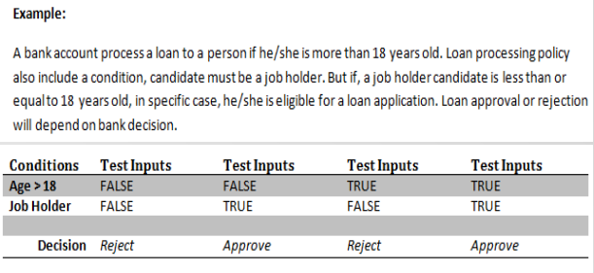
Specification Based – Black Box
Decision Table

Slide 20
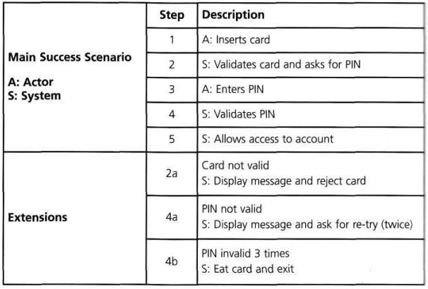
Specification Based – Black Box
Use Case Testing

Slide 21
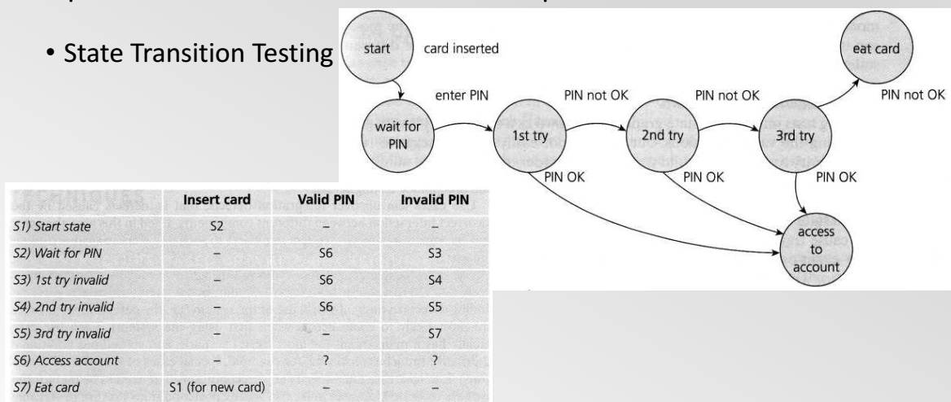
Specification Based – Black Box
State Transition

